Slide 1




Introduction to Computer Programming using C++
Basic of C++
FEU – EAST ASIA COLLEGE
Information Technology Department

Slide 2
Microsoft Visual C++
Microsoft Visual C++ (often abbreviated as MSVC or VC++)
is a commercial, non-free integrated development environment (IDE) product from Microsoft for the C, C++, and C++/CLI programming languages.
It has tools for developing and debugging C++ code, especially code written for the Microsoft Windows API, the DirectX API, and the Microsoft .NET Framework.

Slide 3
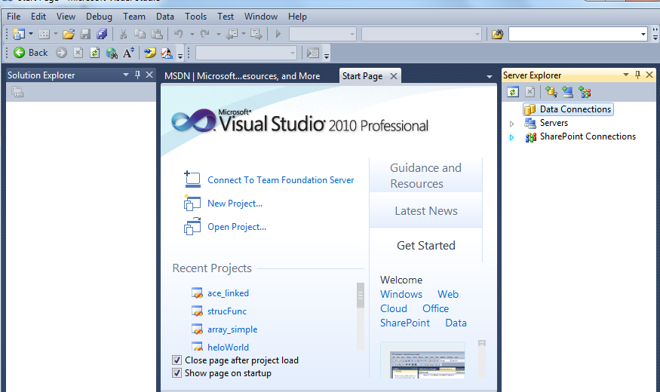
Microsoft Visual C++

Slide 4
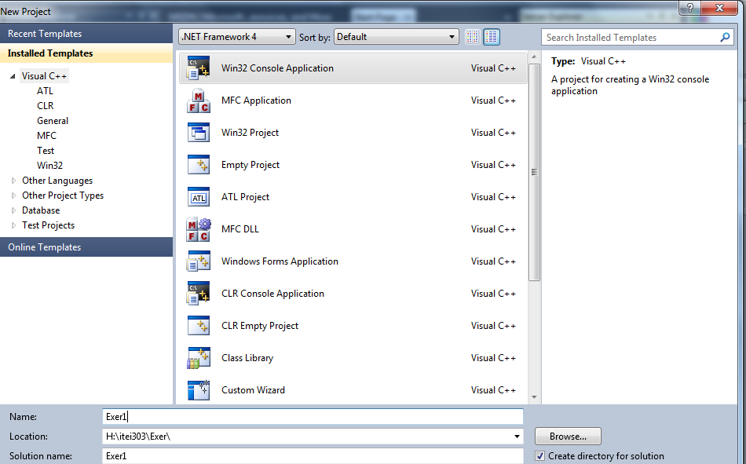
IDE of MSVC

Slide 5

Versions:
There are five current versions of Visual C++ available:
Microsoft Visual C++ 2010 Express Edition
(available as a free download at the MSDN site)
Microsoft Visual Studio 2010 Professional
Microsoft Visual Studio 2010 Team Foundation
Microsoft Visual Studio 2010 Premium
Microsoft Visual Studio 2010 Ultimate
Note: Visual C++ is included in Visual Studio.
FEU – EAST ASIA COLLEGE
Information Technology Department

Slide 6
Structure of C++ program
<preprocessor directives>
<global declarations>
<main body of the Program>
#include <iostream>
int num, a, b;
int main()
{
line of codes;
return 0;
}

Slide 7
Basic Example of C++ program
// my first program in C++
#include <iostream>
using namespace std;
int main ()
{ cout << "Hello World!";
return 0;
}
FEU – EAST ASIA COLLEGE
Information Technology Department

Slide 8
Structure of C++ Program
// my first program in C++
This is a comment line. All lines beginning with two slash signs (//) are considered comments and do not have any effect on the behavior of the program.
#include <iostream>
Lines beginning with a hash sign (#) are directives for the preprocessor. This specific file (iostream) includes the declarations of the basic standard input-output library in C++.
FEU – EAST ASIA COLLEGE
Information Technology Department

Slide 9
using namespace std;
All the elements of the standard C++ library are declared within what is called a namespace, the namespace with the name std.
int main ()
This line corresponds to the beginning of the definition of the main function. The main function is the point by where all C++ programs start their execution.

Slide 10
cout << "Hello World!";
This line is a C++ statement. A statement is a simple or compound expression that can actually produce some effect.
Each statement must be terminated by a semicolon (;)
return 0;
The return statement causes the main function to finish, return may be followed by a return code 0;
FEU – EAST ASIA COLLEGE
Information Technology Department

Slide 11
Sample Program
// my second program in C++
#include <iostream>
using namespace std;
int main ()
{ cout << "Hello World! ";
cout << "I'm a C++ program";
return 0;
}
OUTPUT: ???
FEU – EAST ASIA COLLEGE
Information Technology Department
Notes:
Hello World! I'm a C++ program

Slide 12
Comments
Comments are parts of the source code disregarded by the compiler. Their purpose is only to allow the programmer to insert notes or descriptions embedded within the source code.
C++ supports two ways to insert comments:
// line comment
/* Block comment – with more than one line
comments */
FEU – EAST ASIA COLLEGE
Information Technology Department

Slide 13
#include <iostream>
using namespace std;
int main ()
{
cout << "Hello World! "; // prints Hello World!
cout << "I'm a C++ program"; /* prints I'm a C++ program */
return 0;
}

Slide 14
Identifiers
C Reserved Word
A word that has special meaning in C
Examples of reserved word:
int, void, double, return
FEU – EAST ASIA COLLEGE
Information Technology Department

Slide 15
Identifiers
C Standard Identifier
A word having special meaning but may be redefined (but is not recommended!!)
Examples of standard identifiers:
cin, cout, std
Variable, Constant, Function

Slide 16
Literals
They are used to express particular values within the source code of a program.
a = 5;
the 5 in this piece of code was a literal constant. Literal constants can be: Integer Numerals, Floating-Point Numerals, Characters, Strings, and Boolean Values.
FEU – EAST ASIA COLLEGE
Information Technology Department

Slide 17
Integer Numerals
They are numerical constants that identify integer decimal values.
Example: 105, 1025, -895
Floating Point Numbers
They express numbers with decimals and/or exponents.
Example: 3.14159 // 3.14159
6.02e23 // 6.02 x 10^23
1.6e-19 // 1.6 x 10^-19
FEU – EAST ASIA COLLEGE
Information Technology Department

Slide 18
The default type for floating point literals is double. If you explicitly want to express a float or a long double numerical literal, you can use the f or l suffixes respectively: 3.14159L // long double
6.02e23f // float
Boolean literals
There are only two valid Boolean values:
true and false.
FEU – EAST ASIA COLLEGE
Information Technology Department

Slide 19
Character and string literals
Non-numerical constants, like: 'z'
'p'
"Hello world"
"How do you do?"
Single character uses single quotes (') and to express a string (which consists of more than one character) uses double quotes (").
FEU – EAST ASIA COLLEGE
Information Technology Department

Slide 20
Data Types
Integer: int
Whole numbers (e.g. +16, 568, -456)
The integer types can be additionally defined as
signed or unsigned. The former means that a
number can either be positive or negative.
The latter asserts that the number is always
non-negative.
C++ assumes that all integers are signed
by default.
FEU – EAST ASIA COLLEGE
Information Technology Department

Slide 21
Data Types
Character: char
An individual character value – a letter, a digit or a symbol (e.g. ‘A’, ‘4’, ‘*’)
Float: float
A real number which has a decimal point (e.g. 8.00, 3.1416)
High-level Float: double

Slide 22
C++ Numeric Data Types
Type | Size in Bytes | Stores
short | 2 | Small integers, from -32,768 to 32, 767 signed or 0 to 65,535 unsigned
int | 2 or 4 | Integers with same range as short or long
long | 4 | Large integers, from -2,147,483,648 to 2,147,483,657 or 0 to 4,294,967,295
float | 4 | Floating-point numbers (decimals)
double | 8 | Double-precision floating-point numbers
long double | 10 | Large double-precision floating-point numbers

Slide 23
Variable
A name associated with a memory cell. Its value may change.
Must be declared before using
Declaration syntax:
data_type variable_name;
Example:
int x;
int entry_time, charge;
FEU – EAST ASIA COLLEGE
Information Technology Department

Slide 24
Rules in giving Variable Names
Consist of only letters, digits, and underscore
Begins with either a letter or an underscore
Case sensitive
Cannot contain spaces
Cannot be the same as an existing C++ keyword
(such as int, return, main)
FEU – EAST ASIA COLLEGE
Information Technology Department

Slide 25
Variable Declaration
Example:
int quantity;
char mid_initial;
float price;
double weight;
Example:
unsigned int zip_code;
int x = 4;
FEU – EAST ASIA COLLEGE
Information Technology Department

Slide 26
Assigning Values to Variables
Algorithm
variable ← expression
Syntax
variable = expression;
Rules
Expression’s type must be the same
as variable’s type
Valid Example: Invalid Example:
int x; int y;
x = 12; y = 5.75;
FEU – EAST ASIA COLLEGE
Information Technology Department

Slide 27
Assigning Values to Variables
Example:
int number1, number2;
int x, y, z;
number1 = 25; number2 = 23;
number1 = number2;
x = y= z = 20;
After execution the lines what is the value of number1, number2, x, y, and z = ???
FEU – EAST ASIA COLLEGE
Information Technology Department

Slide 28
Assigning Values to Variables
The other way to initialize variables, known as constructor initialization, is done by enclosing the initial value between parentheses ().
Syntax:
data_type variable_name(initial_value);
Example:
int num(10);
FEU – EAST ASIA COLLEGE
Information Technology Department

Slide 29
Example: include <iostream>
using namespace std;
int main ()
{
int a=5;
int b(2);
int result;
a = a + 3;
result = a - b;
cout << result;
return 0;
}

Slide 30
Example:
include <iostream>
using namespace std;
int quantity = 2;
float price_per_kg, price;
int main ()
{ price_per_kg = 4.50;
price = quantity * price_per_kg; cout << price;
return 0;
}
FEU – EAST ASIA COLLEGE
Information Technology Department

Slide 31
Constant
A value that will not change.
With the const prefix you can declare constants with a specific type in the same way as you would do with a variable:
Example:
const int StartYear= 2005;
const float pi = 3.14159;
FEU – EAST ASIA COLLEGE
Information Technology Department

Slide 32
Defined Constants (#define)
Defining own names for constants by using the #define preprocessor directive.
Syntax: #define identifier value
For example: #define pi 3.14159
#define taxrate 0.0725
FEU – EAST ASIA COLLEGE
Information Technology Department

Slide 33
Example
// defined constants: calculate circumference
#include <iostream>
using namespace std;
#define pi 3.14159
#define NEWLINE '\n'
int main ()
{ double r = 5.0; // radius double circle;
circle = 2 * pi * r;
cout << circle; cout << NEWLINE;
return 0;
}
FEU – EAST ASIA COLLEGE
Information Technology Department

Slide 34
Escape Codes
Special characters that are difficult to express in the source code. Preceded by a backslash (\).
\n newline
\r carriage return
\t tab
\v vertical tab
\b backspace
\f form feed (page feed)
\a alert (beep)
\' single quote (') \
\" double quote (")
\? question mark (?)
\\ backslash (\)
FEU – EAST ASIA COLLEGE
Information Technology Department

